Slide 1

BUAN 6356 BUSINESS ANALYTICS WITH R – GROUP 14 PROJECT
Heart Attack Prediction

Slide 2
OBJECTIVE:
Our main Objective is to develop effective strategies for identifying and mitigating diverse risk factors contributing to heart disease, conduct a comprehensive analysis to identify and mitigate diverse risk factors, encompassing environmental influences, dietary patterns, and lifestyle choices, to significantly reduce the prevalence of heart disease and improve overall health outcomes.

Slide 3

Introduction:
We aim to tackle heart problems and monitor changing habitats. Predictions suggest that 44% of US adults will face cardiovascular disease by 2030. Addressing risk factors like smoking, obesity, and inactivity can lower the risk..

Slide 4
Insight Generation Points:
Conducted a thorough analysis of a diverse health dataset to understand the foundational aspects.
Identified correlations among specific health indicators, potentially linked to heart disease.
Created predictive models for assessing the likelihood of individuals developing heart disease.
Selected the most effective predictive model for identifying potential heart disease risks based on thorough evaluations.
Discerned whether specific health indicators elevated an individual's risk of developing heart disease.

Slide 5
ATTRIBUTE INFORMATION:
This dataset contains 1 binary target variable, 8 categoric and 5 numeric attributes.
Attributes ‘Age’ and ‘Sex’ are used as Demographic and Clinical Information that can help in risk stratification.
Attributes 'CP' (Chest pain type) , 'TRTBPS' (Resting blood pressure), 'CHOL' (Cholesterol), 'FBS' (Fasting blood sugar), 'RESTECG' (Resting electrocardiographic results), 'THALACHH' (Maximum heartrate achieved), 'OLDPEAK' (ST depression), 'CAA' (Number of major blood vessels), 'THALL' (Thallium stress result test), 'EXNG' (Exercise induced angina) are Cardiovascular Health Indicators that serve as critical biomarkers for disease progression and severity, offering predictive insights into potential heart issues.
'Age' ,'TRTBPS' (Resting blood pressure), 'CHOL' (Cholesterol), 'THALACHH' (Maximum heartrate achieved), 'OLDPEAK' (ST depression) are the numeric attributes
'Sex', 'CP' (Chest pain type), 'FBS' (Fasting blood sugar), 'RESTECG' (Resting electrocardiographic results), 'CAA' (Number of major blood vessels), 'THALL' (Thallium stress result test), 'EXNG' (Exercise induced angina) and ‘SLP’(Slope of peak exercise segment) are categorical attributes.

Slide 6
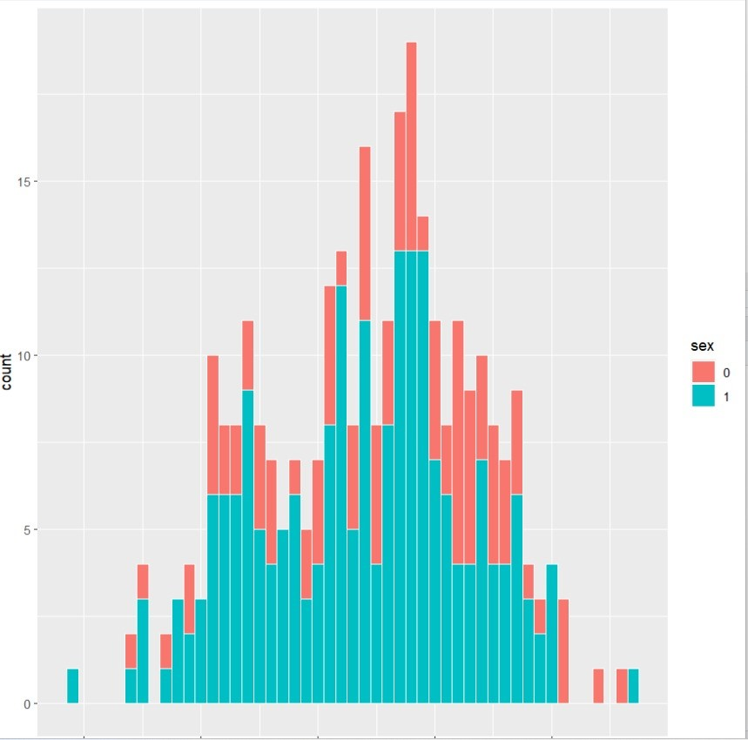
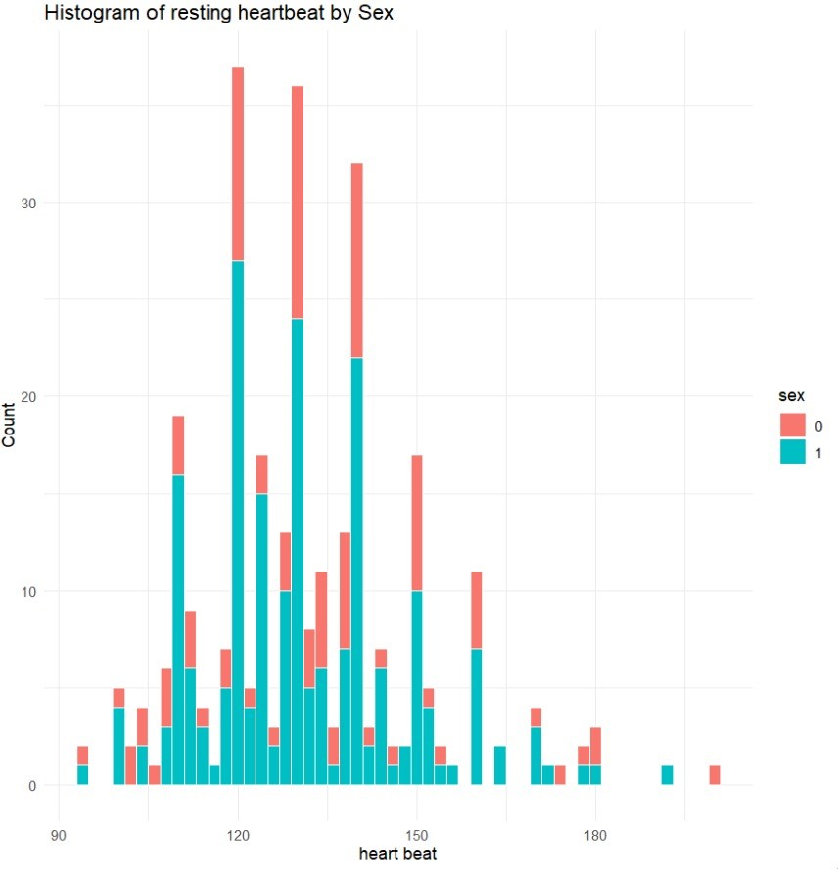
Exploratory Data Analysis
Age:
Trtbps:
The graphical depiction of the age-related data is displayed in the histogram, 29 years is the minimum, 54.37 years is the mean, and 77 years is the maximum.
The resting blood pressure graphical data is displayed on this graph. There is a minimum of 94 units, a mean of 131.6 units, and a maximum of 200 units.

Slide 7
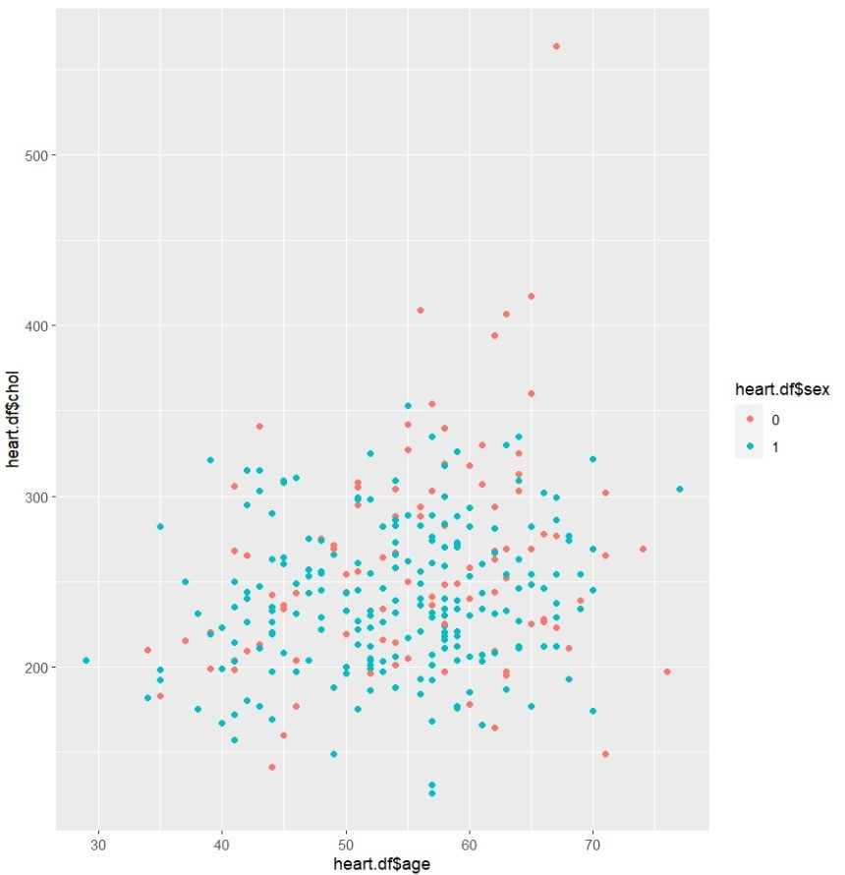
Age vs Cholesterol:
Elderly women between the ages of 60 and 70 are more likely to have cholesterol, as evidenced above. Regarding men, however, it is difficult to determine at what age they are more likely to develop cholesterol.

Slide 8
Data Pre-processing:
Training and Validation split is kept as 80% and 20% respectively.
The dataset was clean and there were no null values requiring no alterations
We detected outliers in four attributes; however, due to the significance of these values for analysis, we refrained from excluding them

Slide 9
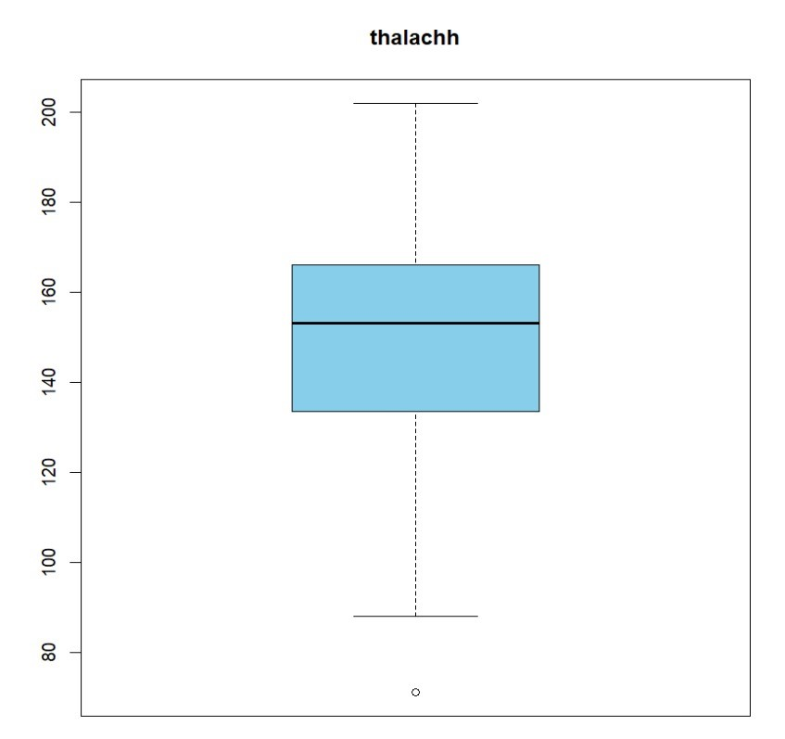
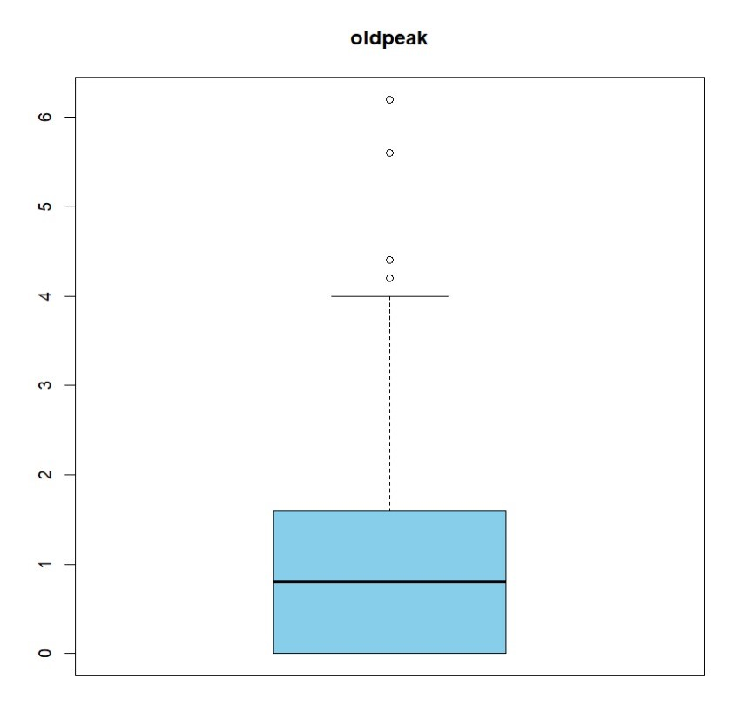
Outliers
We find one outlier that is below 75, but since it falls within the typical range for resting heart rate, we leave it in place because it shows that the subject is healthy
We find four outliers in this variable that are larger than four, but we leave them in place because higher old peak values can be indicative of significant cardiac problems.

Slide 10
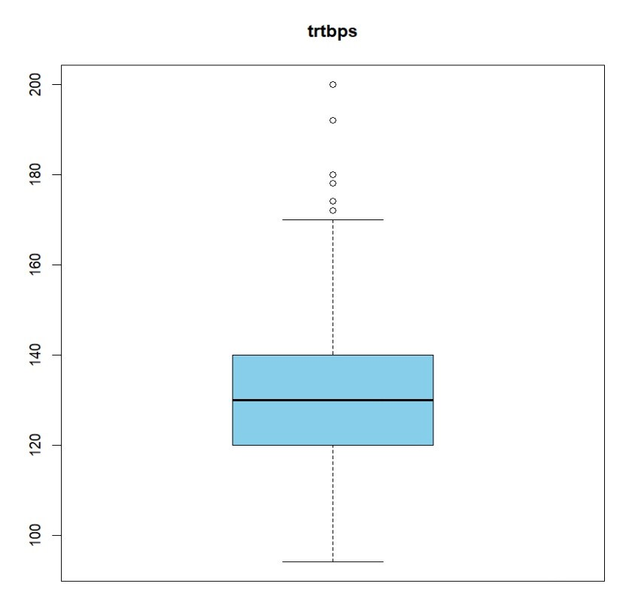
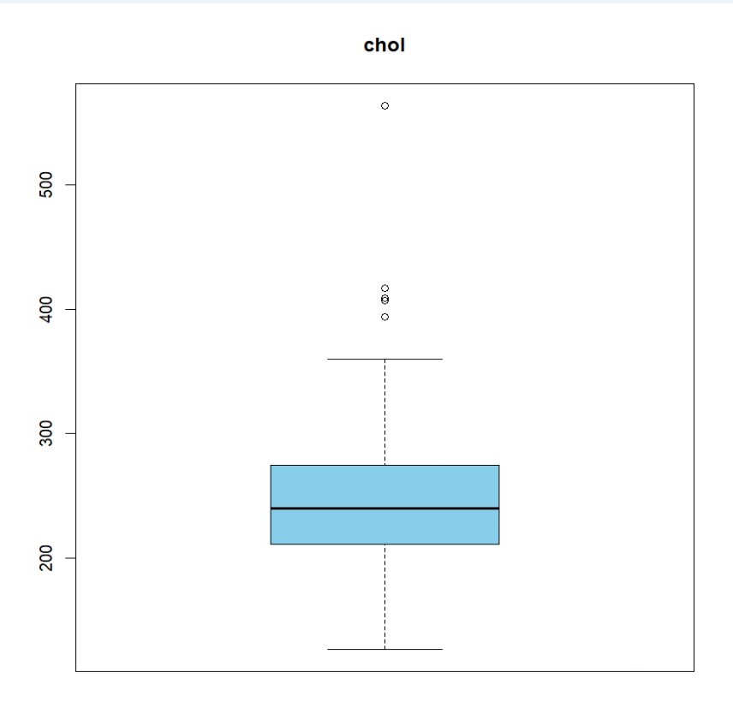
Five outliers, or roughly 400 or more, were noted. Since the normal range for cholesterol is between 200 and 240, we leave these outliers in place because they indicate critical levels that need to be addressed right away
We identified that there are six resting blood pressure outliers three of which are 180 or higher. We leave these outliers in place since blood pressure measurements above 180/110 are regarded as hypertensive crises.

Slide 11
Performance Evaluation
Prediction error rate comprehension aids in evaluating the regression model's performance.
Assessing the regression line's alignment with the dataset provides insight into model accuracy.
Understanding the efficacy and accuracy of these methodologies assists in gauging overall model performance.

Slide 12
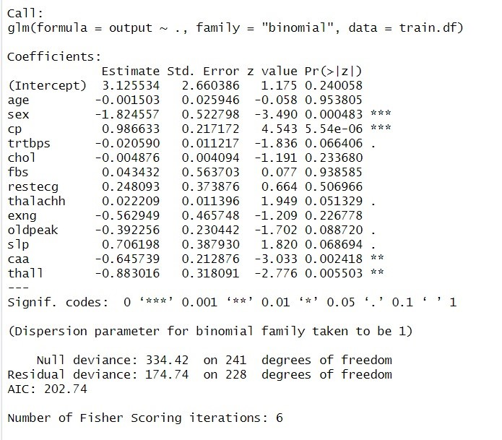
Logistic Regression Model:
Summary for Logistic Regression Analysis:

Slide 13
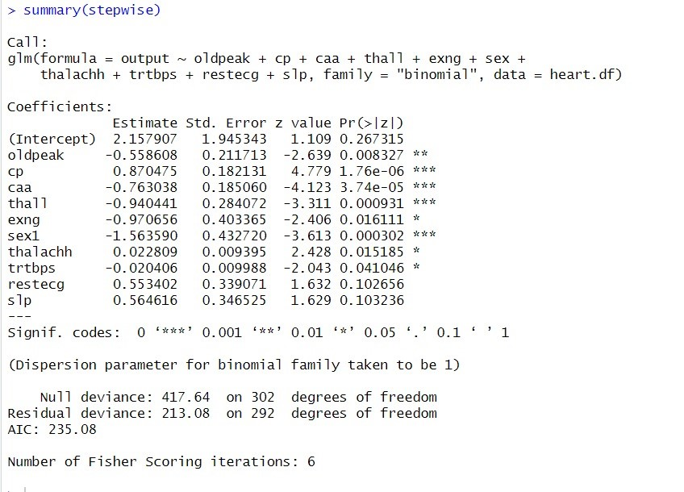
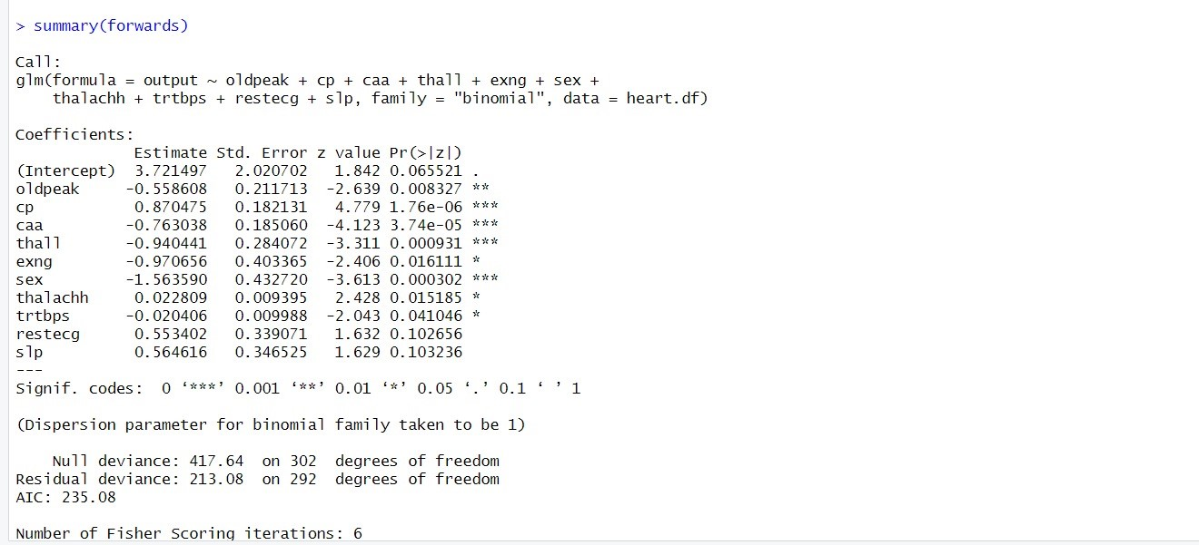
Summary for Logistic Regression Using Stepwise AIC:
Summary for Logistic Regression Using Forward Selection:

Slide 14
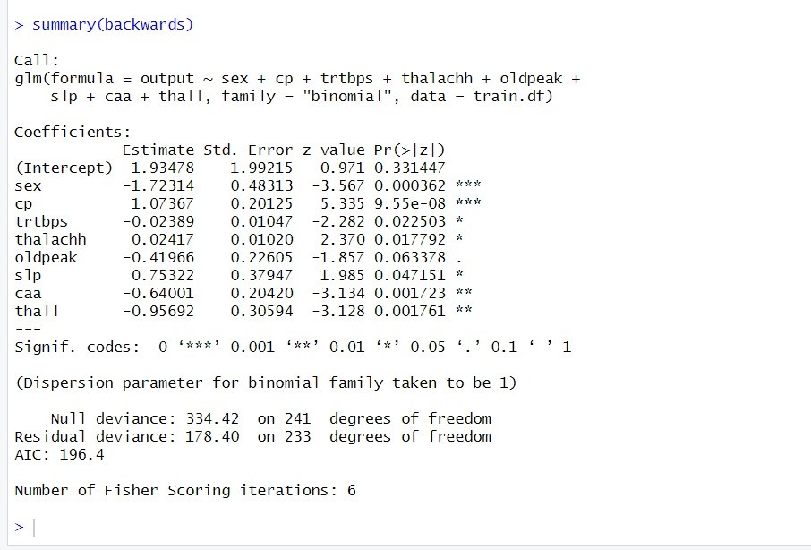
Summary for Logistic Regression Using Backward Elimination:

Slide 15
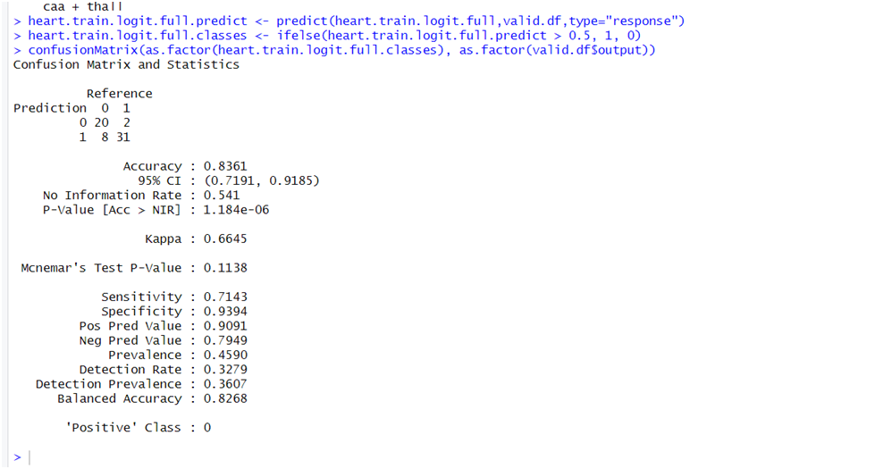
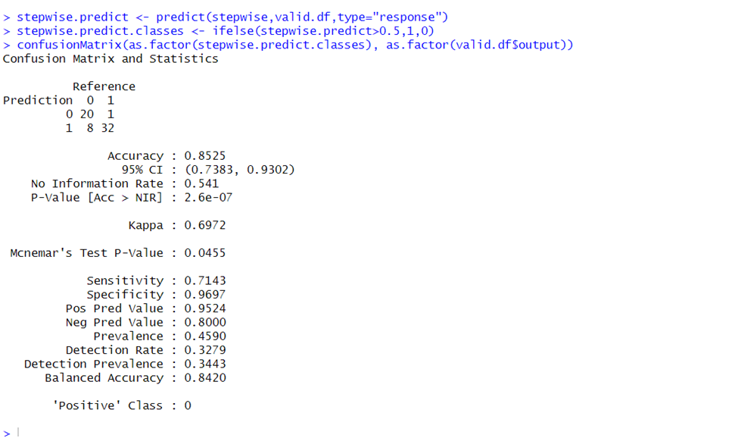
Confusion Matrix for Logistic Regression Using Stepwise AIC:
Confusion Matrix for Logistic Regression

Slide 16
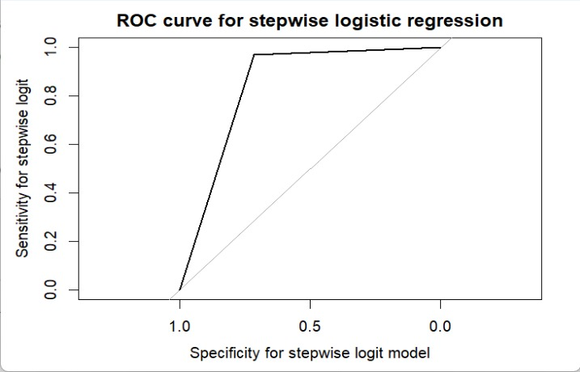

Slide 17
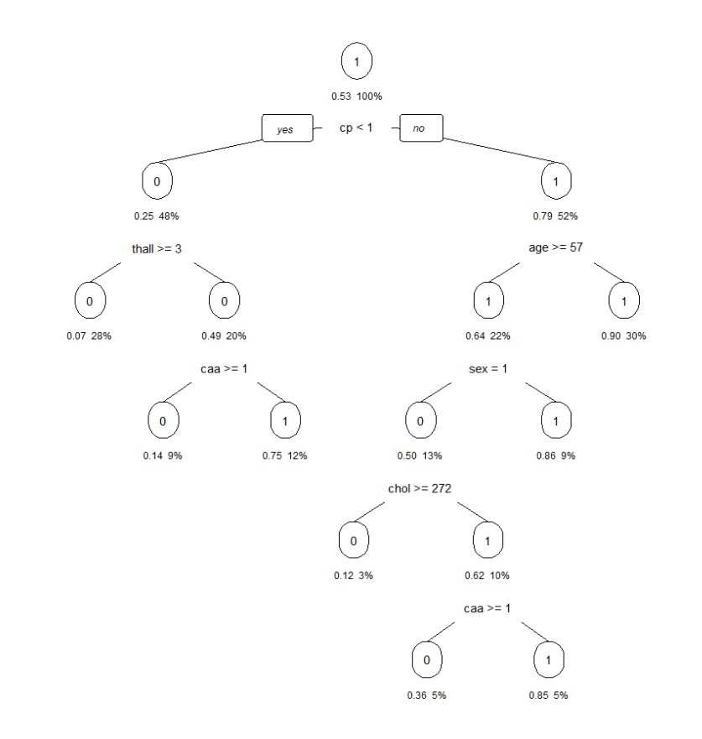
Decision Tree Model

Slide 18
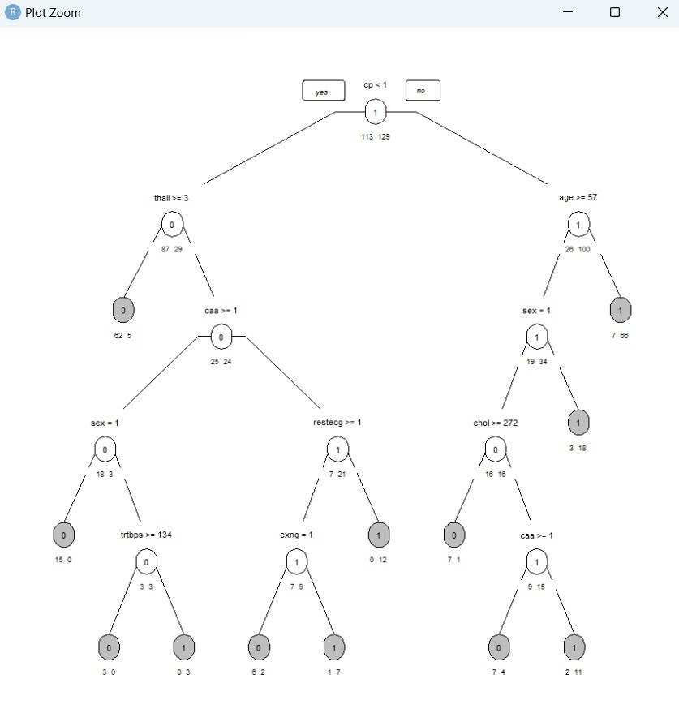
Post Pruned Decision Tree

Slide 19
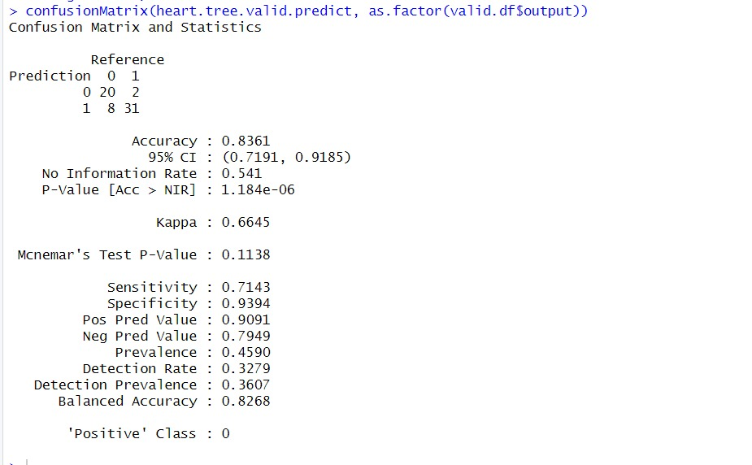
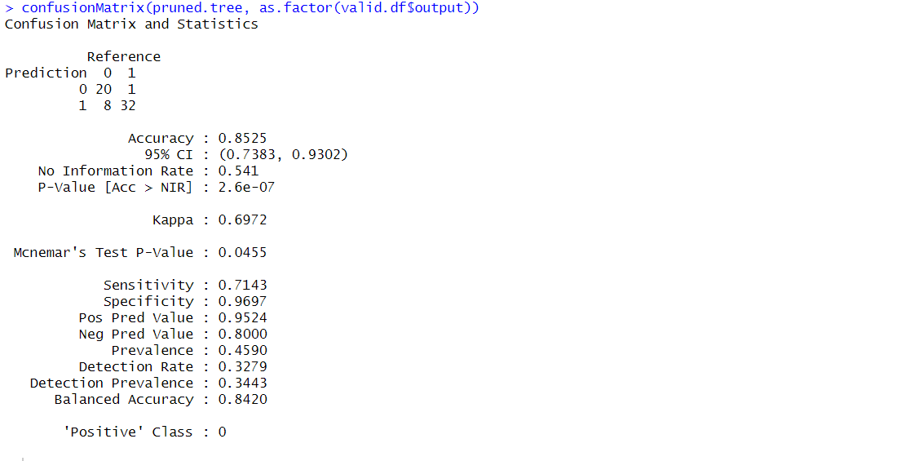
Confusion Matrix for Decision Tree
Confusion Matrix for Pruned Decision Tree

Slide 20
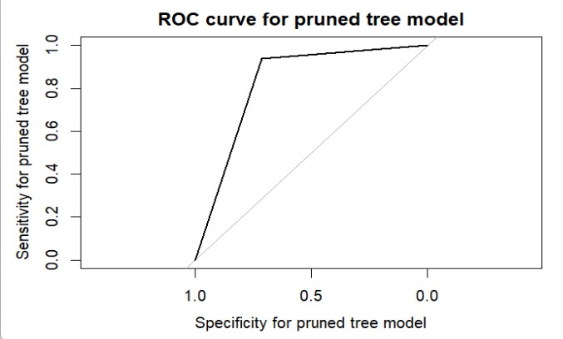
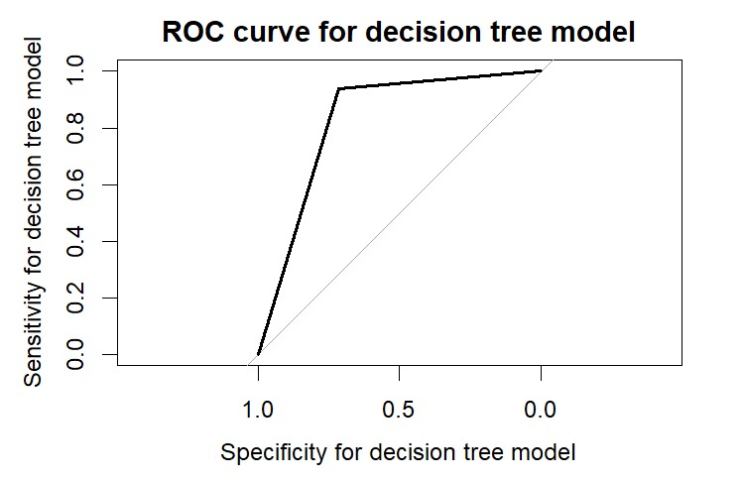

Slide 21
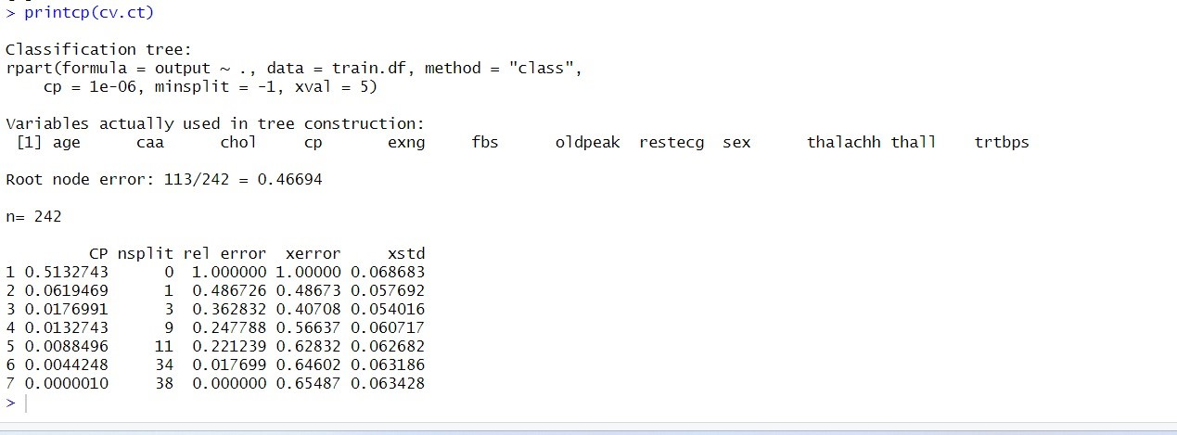
Complexity -parameter table of cross- validation errors

Slide 22
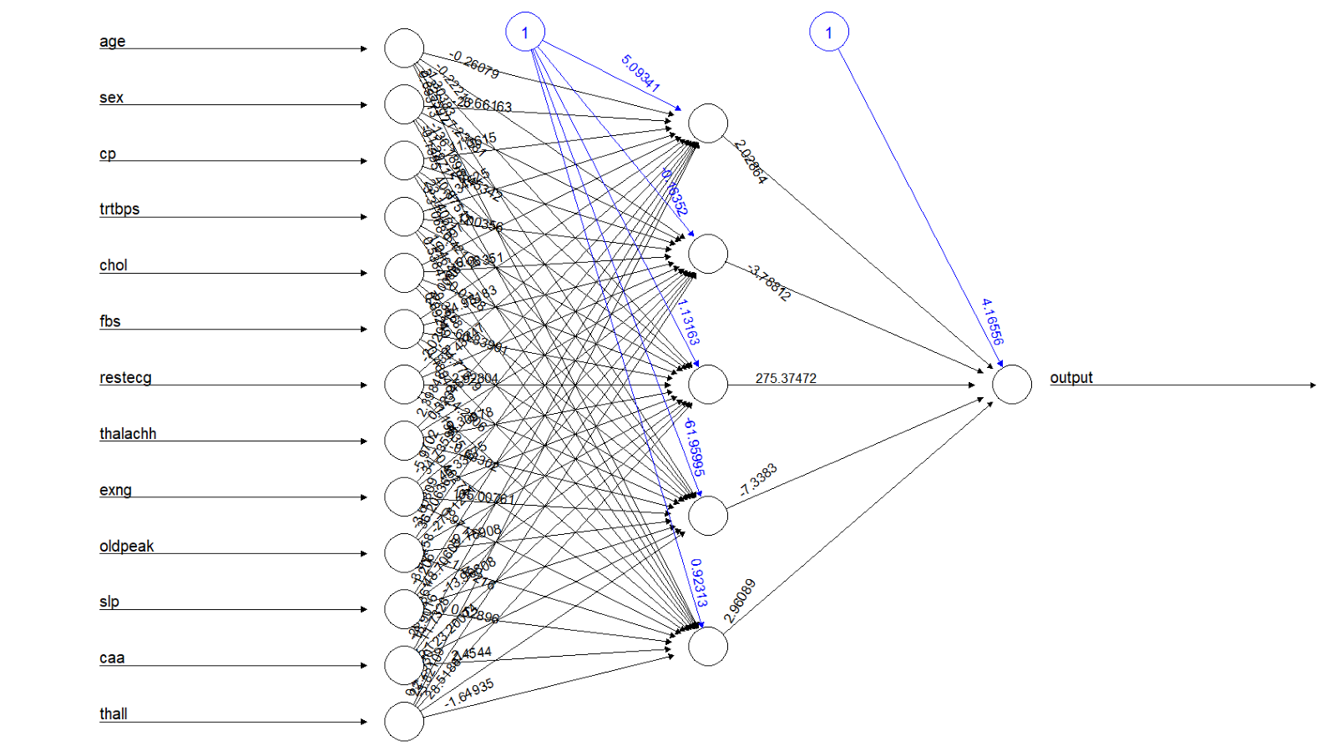
Neural Network

Slide 23
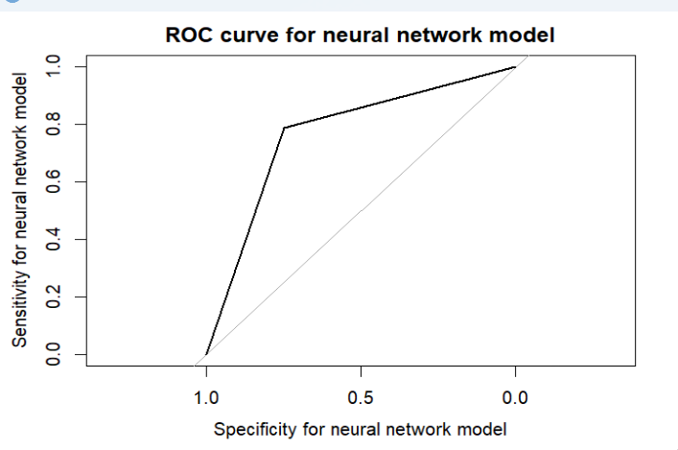
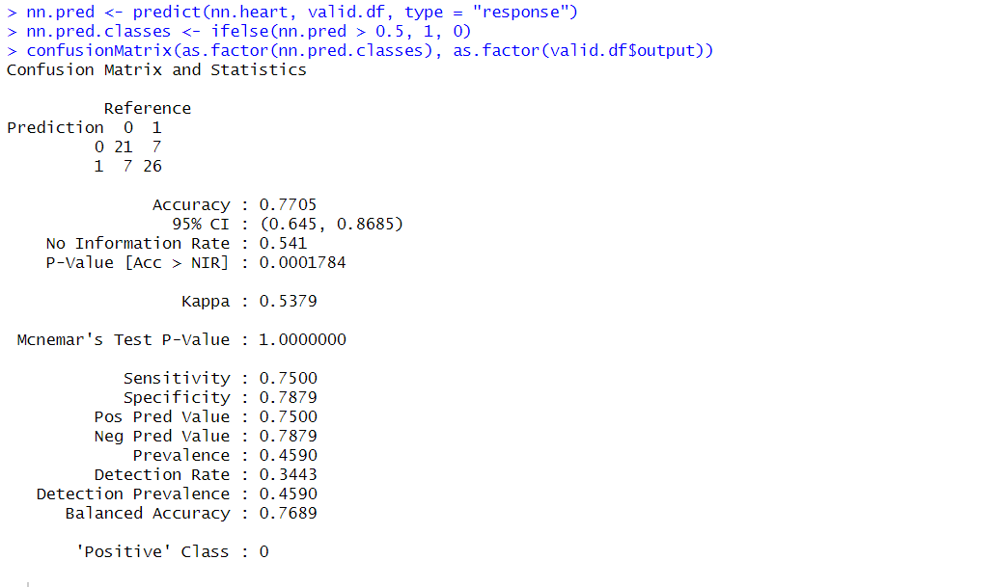
Confusion Matrix for Neural Network:

Slide 24
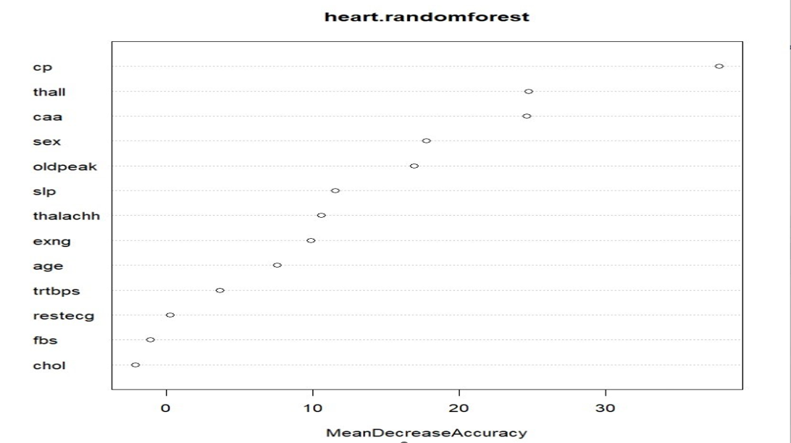
Random Forest
Variable importance plot i.e. significance of the variables

Slide 25
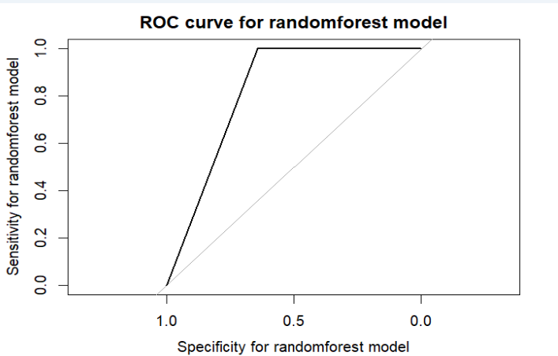
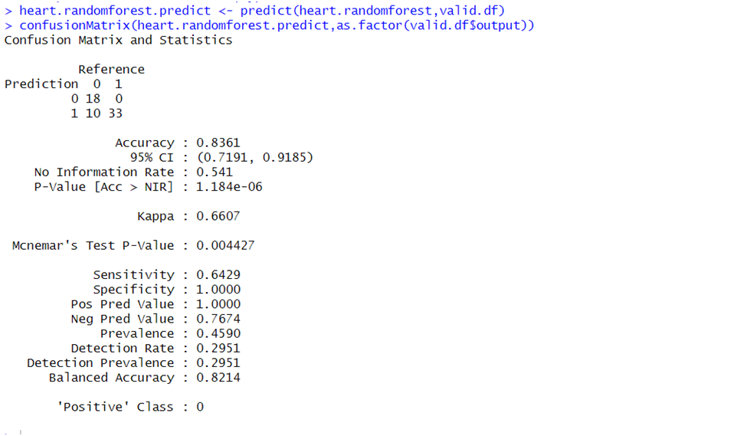
Confusion Matrix for Random Forest

Slide 26
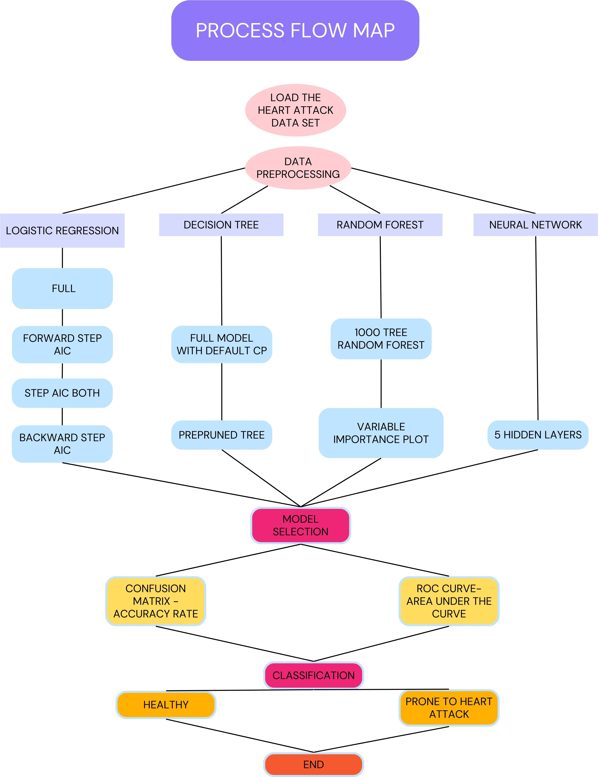

Slide 27
Conclusion:
Model | Accuracy | Recall | AUC
Decision Tree | 85% | 71.43% | 0.848
Random Forest | 82% | 64.29% | 0.809
Neural Network | 77.05 | 75.00% | 0.7689
Logistic Regression | 85.2% | 71.43% | 0.948

Slide 28
Conclusion:
According to our analysis and evaluation Logistic Regression is the best model for this classification with an accuracy of 85.2%.
Top predictors in heart disease analysis: Thallium Stress Test result (Thall), Number of major blood vessels (caa), Chest Pain Type (cp), Exercise induced angina (exng), and ST depression induced by exercise (oldpeak).
Suggests that cholesterol and age hold comparatively less importance as indicators in this analysis.
Logistic regression model showcases robust predictive capacity using demographic, symptom, and vital sign predictors for patient risk stratification.
Recommends potential enhancements through retraining algorithms on larger, more diverse clinical datasets for improved personalized risk profiling.
Suggests a potential implementation on mobile platforms to identify high-risk individuals for preventive interventions or early treatment.
Envisions preemptive care driven by analytics-generated foresight into health outcomes.
Lays the groundwork for scalable, fair risk forecasting by learning from population patterns, aiding various health conditions.
Emphasizes the role of leveraging extensive health data and computational methods in guiding clinical decisions based on statistical insights into real-world events.

